Slide 1


Dual-Link Alert
Integrated NRF Communication and GPS-Based Emergency SMS System

Slide 2


Presentation Main Points
Introduction
The health and communication section
Schematic and circuit
Advantage
Conclusion

Slide 3




Introduction
The situation in Gaza is critical, with its healthcare system overwhelmed by the rising casualties. We're here to innovate and create solutions to aid those in urgent need, streamline emergency responses, and ensure that no cry for help goes unheard.
Our team :
LAOUDI Farid
LADREM Abd-Ul-Haq Amine

Slide 4

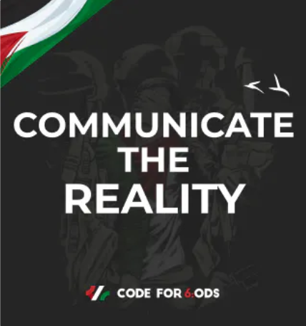
The Health Sector
Communication Sector
Amidst the escalating health crisis in Gaza, the Emergency Connect system emerges as a beacon of innovation designed to manage and mitigate the challenges faced by the medical sector. Utilizing Near Field Radio Frequency (NRF) technology, this system ensures seamless and reliable module-to-module communication, vital for coordinating emergency healthcare services efficiently
the integrated GPS functionality becomes crucial, allowing for
real-time location tracking and swift SMS notifications to emergency responders, ensuring that aid reaches the wounded and at-risk individuals without delay. By reinforcing the communication infrastructure between Palestinians and essential services like hospitals. this system also contributes to the larger narrative by providing transparent and direct communication channels, cutting through the noise of misinformation, and highlighting the on-ground realities in times of crisis

Slide 5
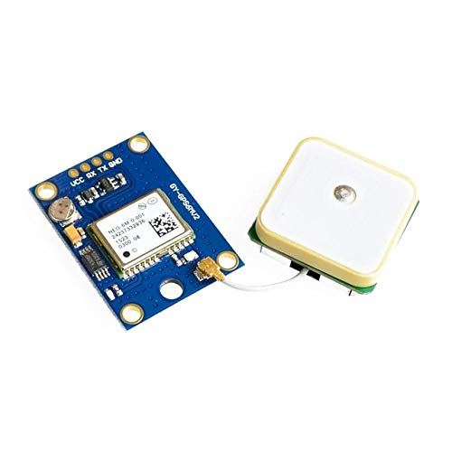
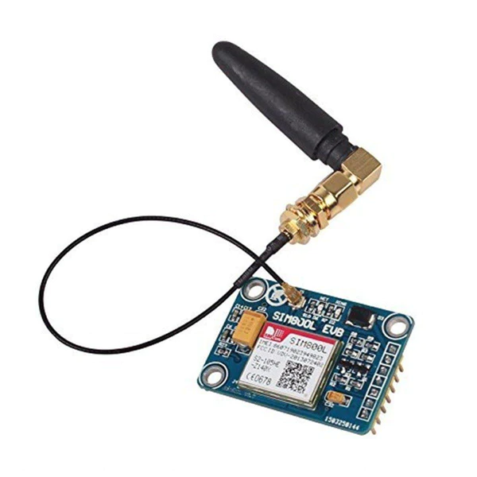
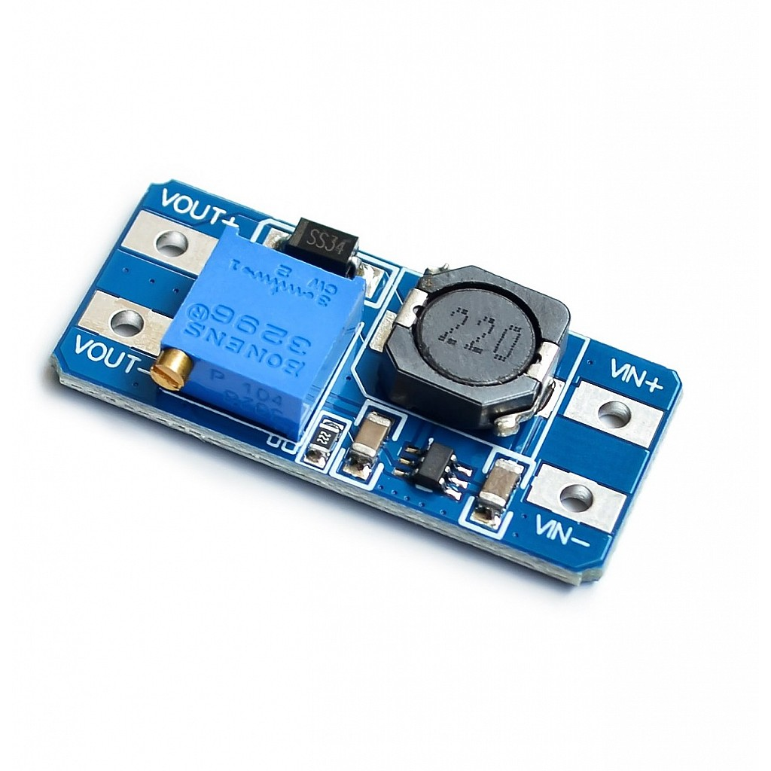
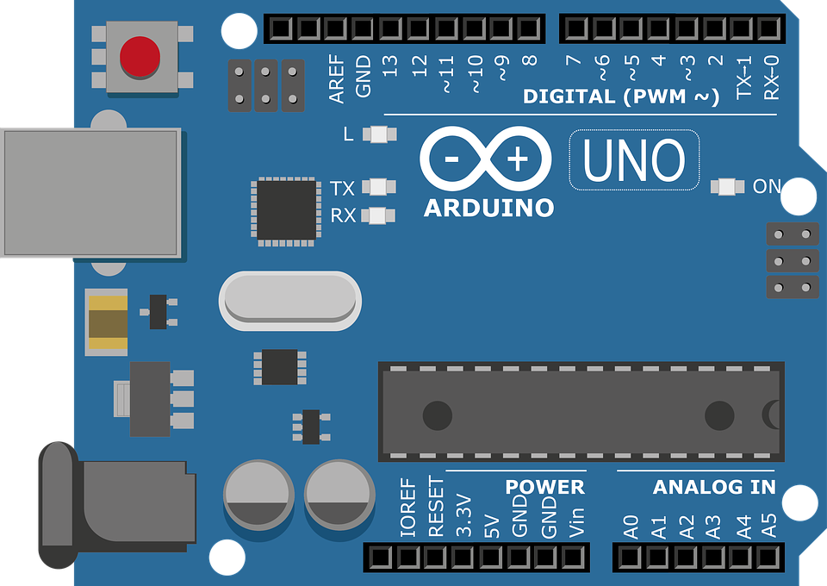

Arduino Uno
GPS module
GSM module
Boost Power Module
Button
A versatile microcontroller platform for creating electronics projects.
A device that provides location data from satellites.
A component that enables mobile communication via calls and SMS.
A circuit that increases voltage from a lower source.
integrated for users to instantly transmit their GPS location data in emergencies.
GPS-Based Emergency SMS System Components

Slide 6
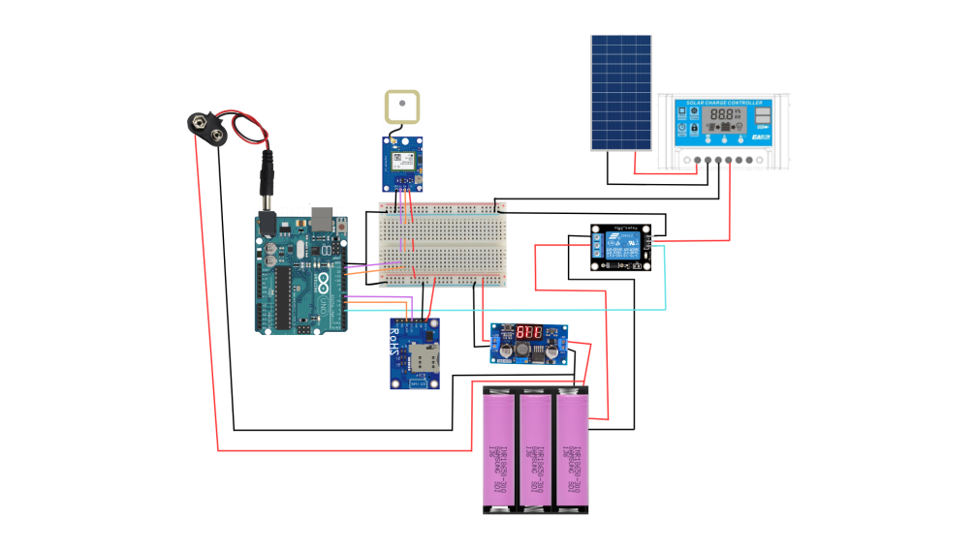

Location Detection: the system uses a GPS module to determine the precise location of an individual in distress. The GPS module receives signals from satellites to calculate the user's geographic coordinates.
Emergency Signal Initiation: When an emergency occurs, the user can push the button as an alert
Data Processing: the system processes the location data and formulates an emergency message. This message includes the GPS coordinates
Message Transmission: the system sends the emergency message as an SMS to predefined phone numbers.
Power Management: To ensure the system remains operational, it can be powered by a solar system. The solar panels collect energy from the sun, which is then converted to electrical power, stored in batteries
1
3
2
4
5
-OPTIONAL-
Solar-Powered Energy System idea to improve the project
GPS-Based Emergency SMS System Components

Slide 7
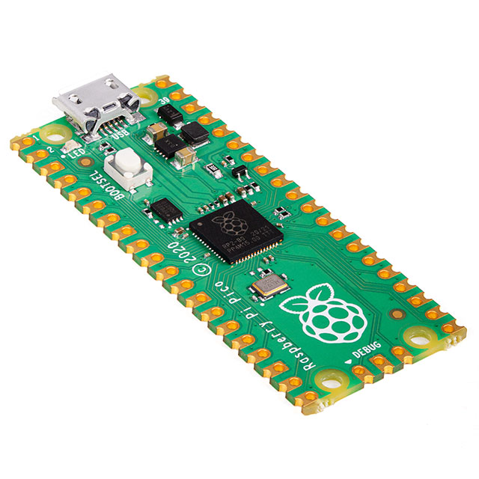
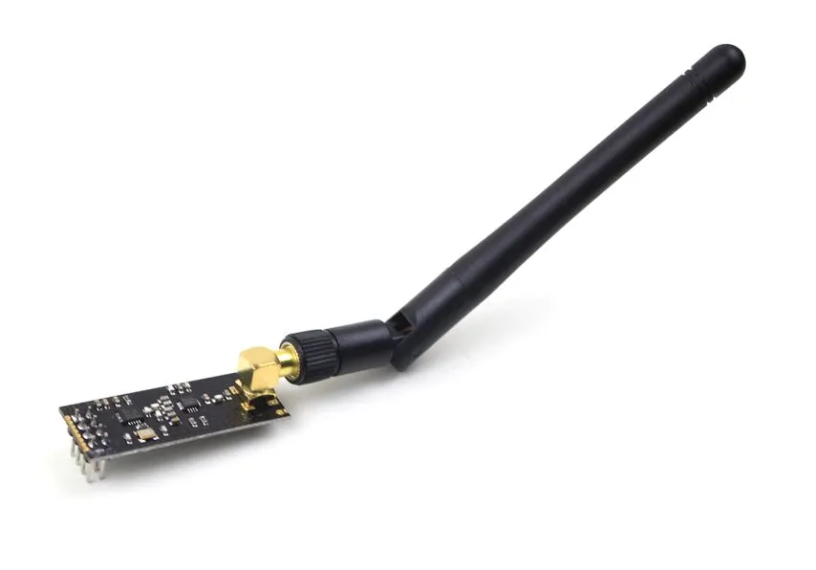

Rasberry pi pico
NRF24L01 Module
10 µF Capacitor
A compact microcontroller for embedded applications.
is a radio transceiver module (SPI protocol) used to send and receive data wirelessly
A passive component for energy storage and filtering.
Integrated Radio Frequency Communication

Slide 8

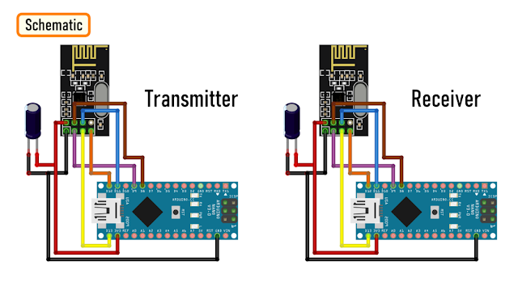
Raspberry Pi Pico: the central control unit that runs the SSH server for secure remote communication with the phone.
Phone: The user interface for the system, allowing you to connect to the Raspberry Pi Pico via SSH to send commands securely.
NRF24L01 Module: This is the wireless transceiver connected to the Raspberry Pi Pico that sends and receives messages wirelessly to another NRF24L01-equipped device within the range.
2
1
Integrated Radio Frequency Communication
For a project that connects a phone to a Raspberry Pi Pico using SSH and sends messages through the NRF24L01 module

Slide 9




Advantage
Security: SSH provides a secure channel for communication, ensuring that data transmitted is encrypted and protected from unauthorized access.
Wireless Communication: The NRF24L01 module facilitates wireless data transmission, eliminating the need for physical wires and enabling easy deployment in various locations without the need of any external network.
Rapid Emergency Alerts: The system can quickly send an SMS with the user's location to emergency services, reducing response times.
Autonomous Operation: With the push of a button, the system autonomously sends out the location without needing further user interaction, which is crucial if the user is incapacitated.
Low Power Consumption: Both the Raspberry Pi Pico and the NRF24L01 are known for their low power consumption, making the system energy efficient and longer-lasting, especially when powered by a solar panel system.
Portability: The compact size of the components makes the system portable and easy to integrate into different environments or for personal use.
Affordability: The components used are widely available and cost-effective, making this a viable solution even with budget constraints.
Open-source Technology: Utilizing open-source platforms like Arduino and Raspberry Pi Pico allows for a vast community support and resource sharing.

Slide 10
Conclusion
In conclusion, our innovative projects, encompassing the NRF communication system and the GPS-based emergency system, stand as powerful tools in the face of Gaza's urgent needs. The NRF system, facilitating secure, wireless communication, can bridge the gap between individuals and essential services, while the GPS-based emergency system ensures rapid deployment of aid by providing precise location data. These systems, powered by sustainable solar energy, are not only cost-effective but also scalable and adaptable to the dynamic challenges faced in Gaza. They represent a beacon of hope, offering a leap forward in medical response and community connectivity. By addressing immediate healthcare crises and fostering clear communication channels, our technologies aim to provide a lifeline to those affected by the ongoing strife, demonstrating the pivotal role of technology in humanitarian efforts.

